Slide 1
Expectations for Year 2
What parents should know
2A- Mrs Shaikh, Year Group Leader
2K- Mrs Khanom
2S- Miss Khatun
2N- Miss Khaliq

Slide 2
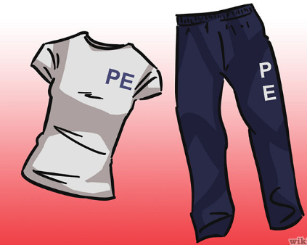
Clothing
Please make sure your child is wearing school uniform and your child’s name is on every item of their clothing. PE bags should be sent with the right clothing every Monday. PE bags must be left in school during the week and be brought home every Friday.
2A – Tuesday and Wednesday
2N – Tuesday and Wednesday
2K – Friday and Wednesday
2S – Monday and Wednesday

Slide 3
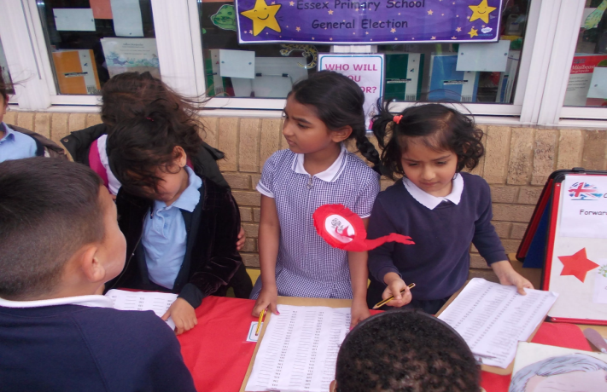
Clothing
Please make sure that your child is wearing the correct uniform.
Children must wear a navy blue jumper or cardigan with the school logo, navy blue skirt or trousers and black shoes. If they are wearing tights they must be navy blue or white. Scarves must be navy blue.
Children must wear stud earrings and not hoops.
Only studs and religious jewellery to be worn.

Slide 4
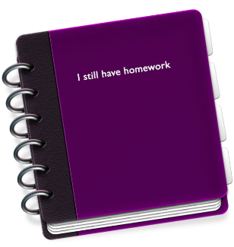
Homework
Children will get homework every Friday. They need to bring their homework book back by Tuesday for it to be marked. Parents should support children with their homework, but please do not do it for them.
Homework

Slide 5
Home reading books
We will change children’s reading books weekly. We want them to read at home every day for at least 20 minutes. They don’t need to finish the book in one sitting. Read a few pages every day and talk about the book. Parents should comment on their child’s reading and understanding of the text in the Reading Record.
Please read to your child at home.

Slide 6
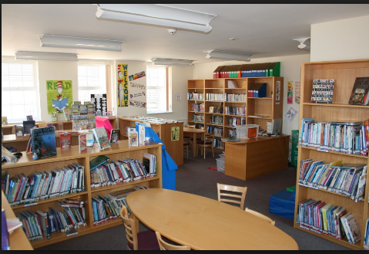
library
Join the local library.
Every 2 weeks the children will be visiting the school library. They will borrow a book each time and take it home. Please make sure the children look after these books and bring them back to school on time.

Slide 7
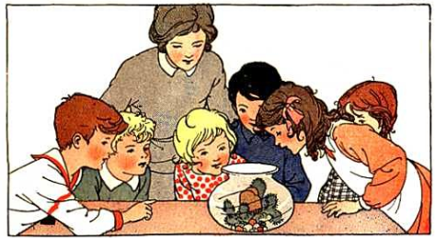
Topics
Children will be learning different topics in Maths and English. You can talk to the children about them e.g. If we are learning about traditional tales, read various traditional tales to them and discuss the story. If we are learning about multiplication, practise these with your child at home.

Slide 8
maths
In Year 2 we have started using a new Maths programme called ‘Maths No Problem’. There is a focus on teaching Maths for mastery and it is designed to improve the Maths confidence of children of all abilities. The whole class works through the programme at the same pace with sufficient time on each topic before moving on. For advanced learners, the textbooks contain more challenging questions for pupils to develop their higher-order thinking skills.
Practise times tables with your child. By the end of Year 2 they should know all multiplication facts for the 2, 5 and 10 times tables.
They will be expected to know their number bonds to 10, 20 and 100.
The children should also be able to count in 2s, 3s and 5s from 0 and in 10s from any number. This will link well to the learning of times tables.

Slide 9
writing
Handwriting – practise correct letter formation.
The children should start Year 2 knowing how to form all letters of the alphabet correctly. By the end of Year 2 the children will be expected to join their writing. Practise this with them at home.

Slide 10
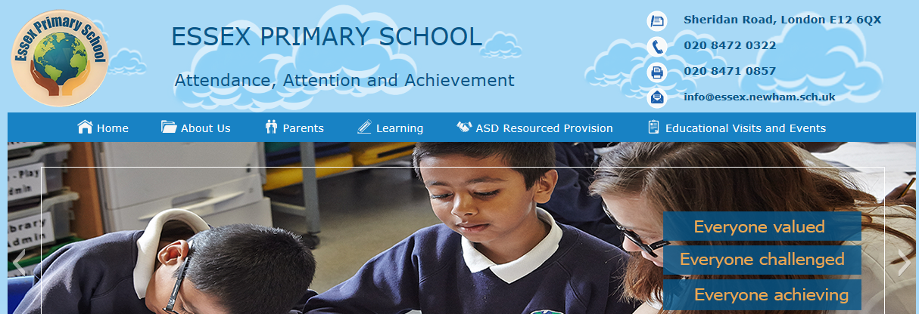
National curriculum expectation
National curriculum expectations for all year groups can be found on our website. Select the learning tab-national curriculum programmes of studies,then scroll down you will see each year group document for the national curriculum expectations.

Slide 11
SATs
All children will sit a national test in May 2018. They will be required to show how they’ve progressed in their Reading, English grammar, punctuation and spelling, and Maths.
Parents should assist their children with their weekly homework and any additional tasks set by the class teacher to help the children meet the standard set by the government.

Slide 12
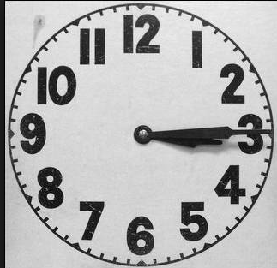
Educational Visits
Educational visits will take place in Year 2. We will notify you of these visits before they take place.
Clubs
If your child signs up for a club and receives a place, please ensure they understand that they have made a commitment and need to attend all sessions. They must be collected on time.
Collecting your child after school
If you are unable to collect your children after school, it’s your responsibility to let the school know who will be coming to collect them. We cannot release your child to an adult if we have not been informed prior to their collection.

