Slide 1
Essex Primary School Year 6 Expectations, 2017-18
‘Parental involvement in children’s education from an early age has a significant effect on educational achievement, and continues to do so into adolescence and adulthood’

Slide 2
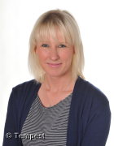
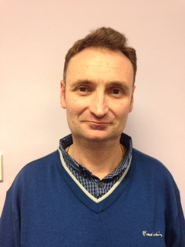
The Year 6 Team
Mrs Chowdhury (Year Group/Phase Lead) – 6C
Ms King– 6K
Mr Allchurch– 6A
Ms. Refiat Musa – 6M

Slide 3
Year 6 Expectations
Children need to be in school on time every morning at 8.55am because they have Early Bird work set for them.
Please make sure that your child’s name is on every item of their clothing and their PE bags are sent with the right clothing every Monday. PE bags must be left in school during the week and be brought home every Friday.
6C & 6A- Tuesday and Thursday
6K & 6M- Monday and Thursday

Slide 4
Year 6 Expectations
Uniform
Children should wear school uniform in the correct colours:
navy blue and white (this includes all hair accessories and head scarves).
No jewellery is to be worn.
Black shoes and a change of shoes for P.E. are required.

Slide 5
Homework
Given on Friday completed/returned by Tuesday
Maths
Mathletics – online
Revision booklets (nearer to SATS)
English
Reading – Comprehension with questions
Punctuation and grammar activity
Spellings: The will need to write a sentence containing the spelling word to show their understanding and its use in context. The children will use the Look, Say, Cover, Write, Check strategy to learn their spellings. Spellings will be assessed through a weekly spelling test.

Slide 6
Online Safety
Have a conversation with your child about online safety.
Explore online together
Know who your child is communicating with online
Set rules and agree boundaries
Make sure that content is age appropriate
Use parental controls to filter, restrict, monitor or report content
Check that you child knows how to use privacy settings and reporting tools

Slide 7
Year 6 Expectations
Reading at Home
We will change their reading books every two weeks. We expect Year 6 pupils to read novels therefore they may not finish the book in one sitting or a week.
We want them to read at home every day. We are keen for the children to progress in their reading, to do this they need to read aloud daily to an adult.
We know our children CAN read fluently but they struggle with comprehending questions. This means it is important you discuss the book with increasing depth through questioning them.
Questions are effective because they:
Give children a purpose for reading
Focus children's' attention on what they are to learn
Help children to think actively as they read

Slide 8
Example of questions:
What has happened in the story so far?
What do you think will happen next?
Who is your favourite character? Why?
Who is the character you like least? Why?
Do you think the author intended you to like / dislike this character? How do you know?
Does your opinion of this character change during the story? How? Why?
Find two things the author wrote about this character that made him / her likeable?
If you met one of the characters from the story, what would you say to him / her?
Which part of the story is your favourite / least favourite? Why?
Would you change any part of the story? How?
Would you change any of the characters? How?
Which part of the story was the funniest/scariest/ saddest/ happiest? Find some evidence in the
text to support your opinion.
What is the purpose of this book? How do you know?
Why is this page laid out in this way? Could you improve it?
Pick three favourite words or phrases from this chapter. Can you explain why you chose them?
Did this book make you laugh? Can you explain what was funny and why?
Have you read anything else by this author? Is anything similar?
Does this book remind you of anything else? How?
When do you think this book was written? How do you know? Does it matter? What would it be like
if it was written now?
Do you think the title of the book is appropriate? What would you have called it?
What is the genre of the book: sci-fi, mystery, historical, fantasy, adventure, horror, comedy? What
are the features that make you think this?
Find two sentences which describe the setting.
Is the plot fast or slow moving? Find some evidence in the text, which supports your view.
If the author had included another paragraph before the story started what do you think it would
say?
Would you like to read another book by this author? Why/ why not?

Slide 9
Year 6 Expectations
Pupils need to write a short comment in their reading record where possible we would like you to also write comments to communicate to us how they are reading at home.
It would be beneficial for your children to join the local library.

Slide 10
Year 6 Expectations
Home alone
In year 6 children are permitted to go home alone only if the parent or carer has signed the home alone slip. Otherwise your child will need to be collected. Please make sure you discuss road safety rules and plan a safe route with them.
If you are unable to collect your child after school, it’s your responsibility to let the school know who will be coming to collect them. We cannot release your child to an adult if we have not been informed prior to their collection.
Clubs
If your child signs up for a club and receive a place please ensure they understand that they have made a commitment and need to attend all sessions.

Slide 11
Key Stage 2 SATs 2018
The key stage 2 tests are timetabled from:
Monday 14 May to Thursday 17 May 2018.
Schools will also be selected for science sampling will be tested from Monday 4 June 2018 ( 2 weeks period).
We will look at the needs of our pupils and arrange Intervention to best support them in their English and Maths.
We will also arrange Saturday School to further push our pupils so they reach their full potential.

Slide 12
Maths
What we do!
2014 New Curriculum Maths Programmes of Study
Teach conceptual understanding of the programmes of study and immerse children in problem solving. Help children reason mathematically and enable them to make links in maths.
What you can do?
Help your child with their homework
Mathletics www.mathletics.co.uk
Nrich www.nrich.maths.org/frontpage

Slide 13
Writing
What we do!
2014 New Curriculum Writing Programmes of Study
Immerse children in the writing process through to ensure children are confident technical writers with composition and effect.
What you can do!
Help your child with their homework
Discuss ideas with your child in relation to their writing topics.

Slide 14
Reading
What we do!
2014 New Curriculum ‘Reading’ Programmes of Study
Guided Reading Sessions, Independent Reading Sessions, Teacher Reading Sessions, Reading Interventions
What you can do!
Help your child with their homework
Reading Records – read with your child everyday for 15 mins and ask them questions based on what you have read
Take them to the library.

Slide 15
Spelling, Grammar and Punctuation
What we do!
2014 New Curriculum ‘English’ Programmes of Study
Spellings, Homework/Tests Grammar and Punctuation lessons. Grammar and Punctuation taught discretely during English.
What you can do!
Help your child with their homework
Practice spellings at home with your child

Slide 16
Science
What we do!
2014 New Curriculum Science Programmes of Study
What you can do!
Help your child with their homework/projects

Slide 17
SATs Revision Books
At Essex Primary School we are always looking for ways to help move children on in their learning. As a result, we will be purchasing10 CGP Key Stage 2 English and Maths revision books for each Year 6 child to enable them to revise in school and at home.
Children will be asked to complete a page of a Revision workbook each day as part of their revision homework. These will be sent home during the Spring break for the children to continue their revision.
Each book costs approximately £4.00. However, the school will ask for a contribution of £10 per child for a set of ten books. We highly recommend them as an excellent resource in assisting us to help your child achieve their potential in the forthcoming SATS tests. We sincerely hope you will support your child’s education. A letter to you will be sent soon.

Slide 18
Secondary School Applications
All applications must be completed online
Information on schools and application through
eadmissions.org.uk

Slide 19
Secondary School Applications

Slide 20
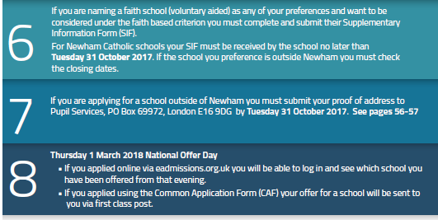
Secondary School Applications

Slide 21
Sex and Relationship Education

Slide 22
Year 6 Expectations
Educational Visits
Visits will take place in Year 6. We will notify you of these trips before they take place.

