Slide 1
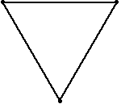

Slide 2
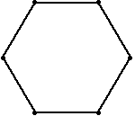
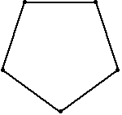
The curves made by the bugs’ tracks are called ‘whirls’.
If we plotted the bugs’ ‘sightlines’ at regular intervals, what might the results look like?
Weisstein, Eric W. "Mice Problem." From MathWorld--A Wolfram Web Resource. http://mathworld.wolfram.com/MiceProblem.html

Slide 3
Source: Daniel Walsh

Slide 4
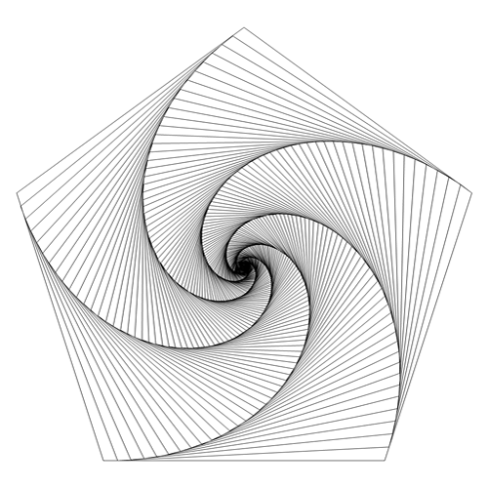
Curves of Pursuit
Source: Devan Matthews, Excelmathart, Tumblr

Slide 5
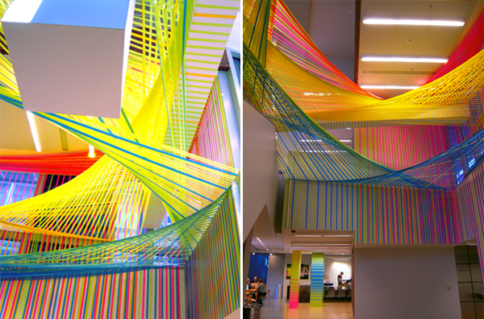
Tape Installation at the Wexner Centre for the Arts, by Megan Geckler

Slide 6
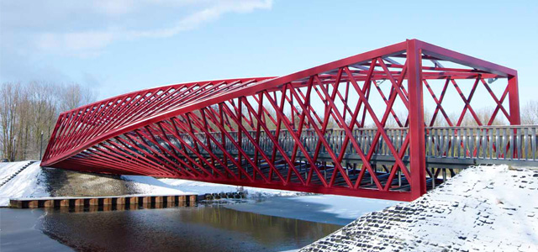
Twisted bridge, Vlaardingen, Netherlands

Slide 7
High Trestle Trail Bridge, Iowa. Photo by Tony Webster

Slide 8
Task: Start by drawing a regular polygon.
Make 4 small marks the same distance in from each side...

Slide 9
then join the marks up...

Slide 10
then join the marks up...

Slide 11
then join the marks up...

Slide 12
then join the marks up...
to make a smaller polygon within the larger one.

Slide 13
And again, make 4 small marks the same distance from each side of the new polygon...

Slide 14
and join the marks up...

Slide 15
and join the marks up...

Slide 16
and join the marks up...

Slide 17
and join the marks up...
to make a smaller polygon within the larger one.

Slide 18
And again, four small marks...

Slide 19
join them up...

Slide 20
join them up...

Slide 21
and on and on....

Slide 23
Constructing a hexagon
Start by drawing a circle

Slide 24
Constructing a hexagon
Mark the centre faintly

Slide 25
Constructing a hexagon
Draw in a faint radius

Slide 26
Constructing a hexagon
With your compasses, draw an arc the same length as the radius

Slide 27
Constructing a hexagon
And another ...

Slide 28
Constructing a hexagon
And another ...

Slide 29
Constructing a hexagon
And another ...

Slide 30
Constructing a hexagon
And one more

Slide 31
Constructing a hexagon
Join up the points to create the hexagon

Slide 32
Constructing a hexagon
Why does this method produce a regular hexagon?

Slide 33
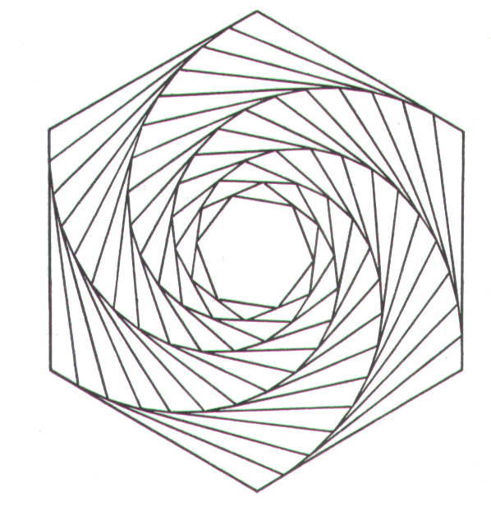
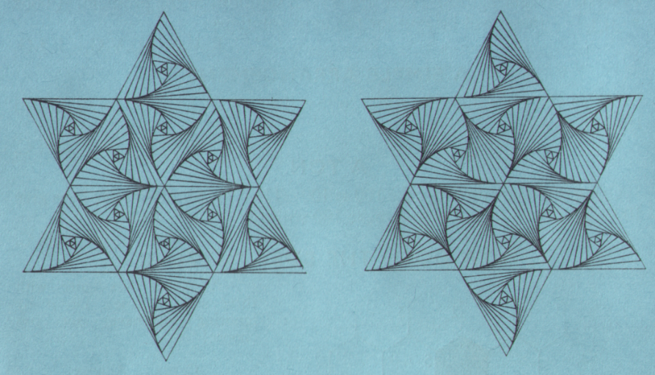
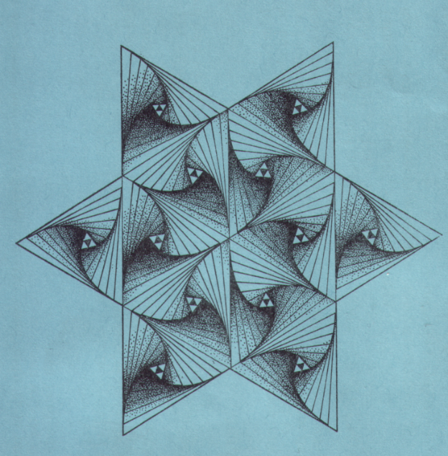
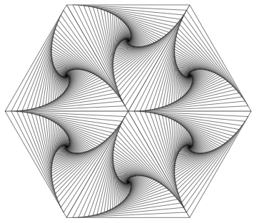
Time to experiment with hexagons!

